Slide 1
Prediction and Analysis of Visa Application Acceptance using Deep Learning
Pranav Bhandari, Dushyant Singh Udawat, Krzysztof Dutka, Leo Franco Soto
December 1, 2022

Slide 2
Notes:
Probably Kristoff

Slide 3
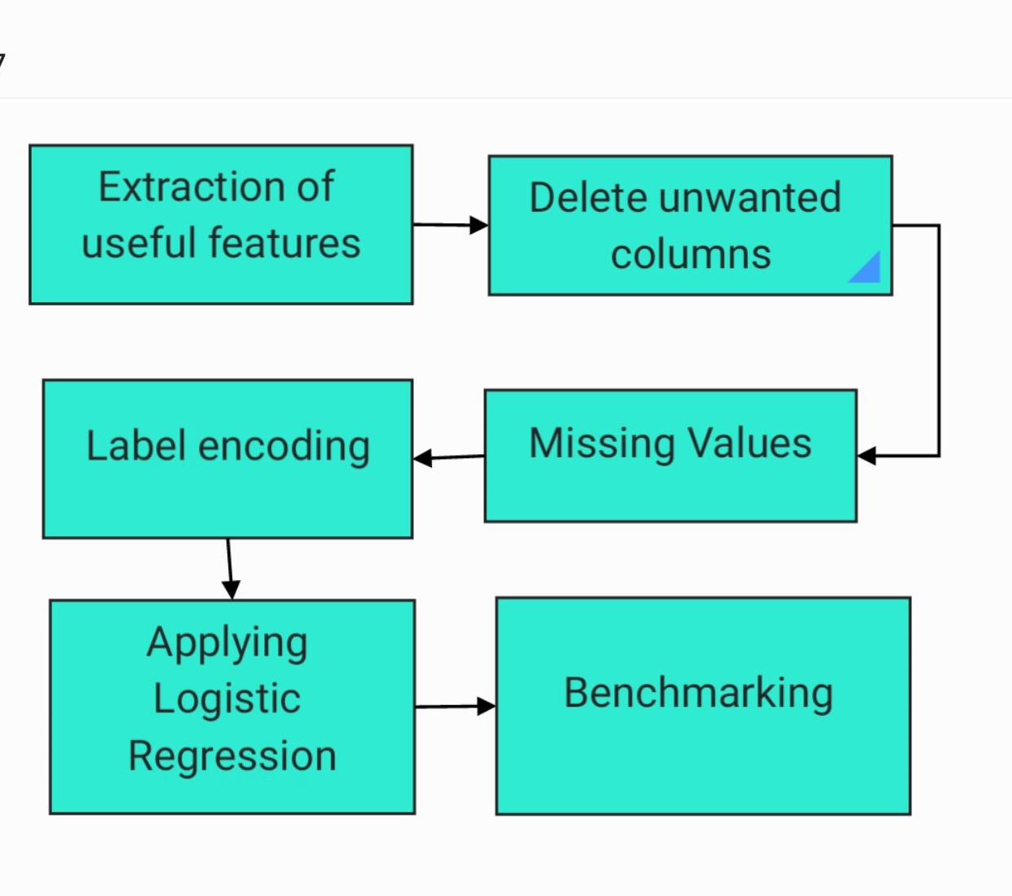
Data preprocessing
Inputs
Employer City
Employer State
Worksite City
Worksite State
No. of Employees in Worksite
Application Date
Outputs
Status of Application
Code by - Dushyant.
Notes:
Add a table of input and output features.
Add a flowchart of steps in preprocessing.
Dushyant

Slide 4
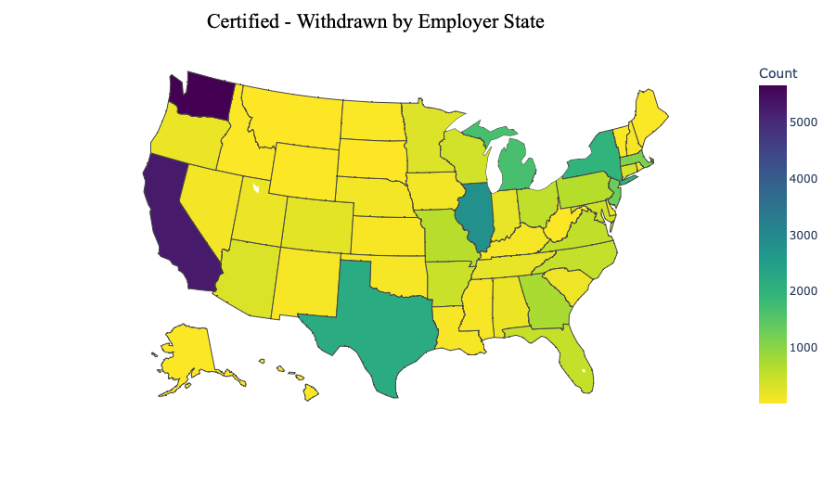
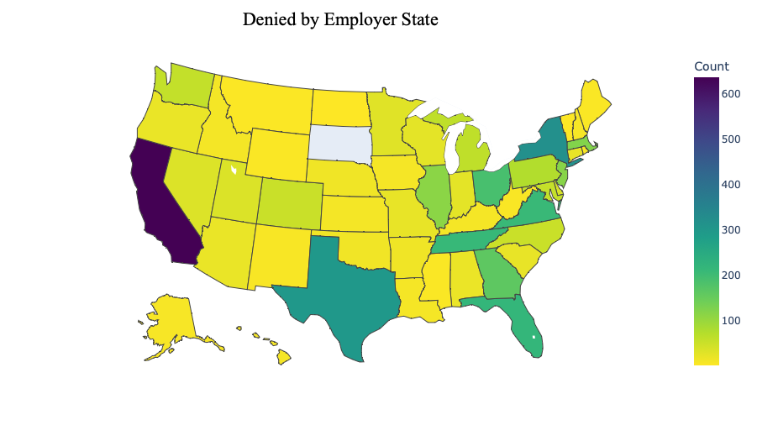
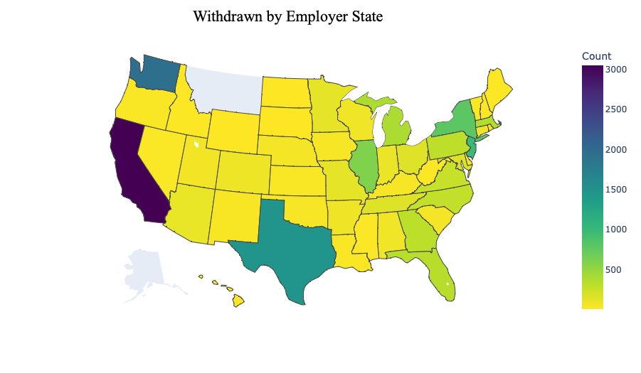
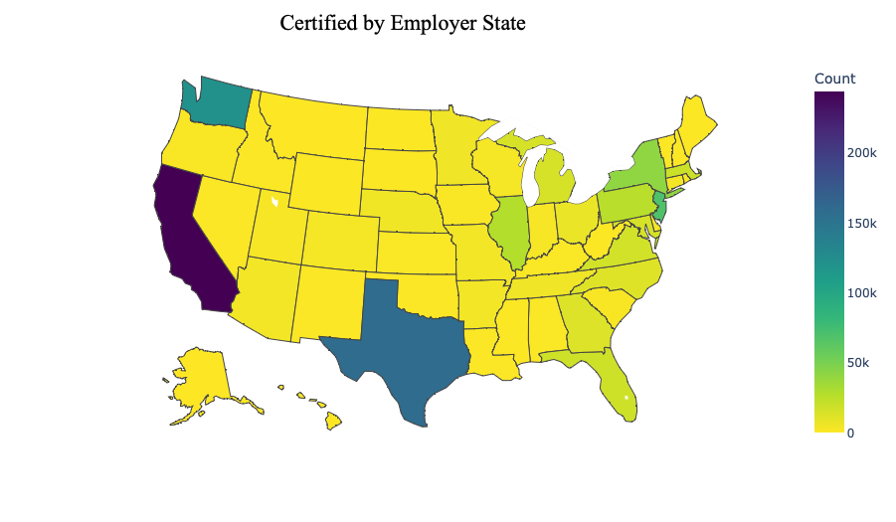
Data Visualization Maps by Employer State
Slide and Code by: Pranav Bhandari (ppb4)

Slide 5
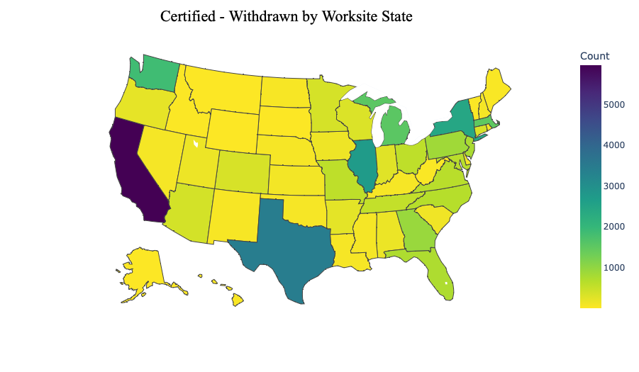
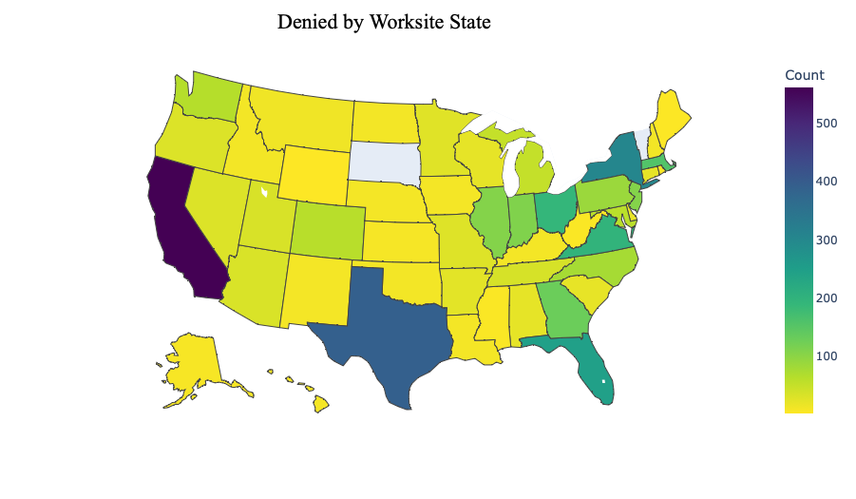
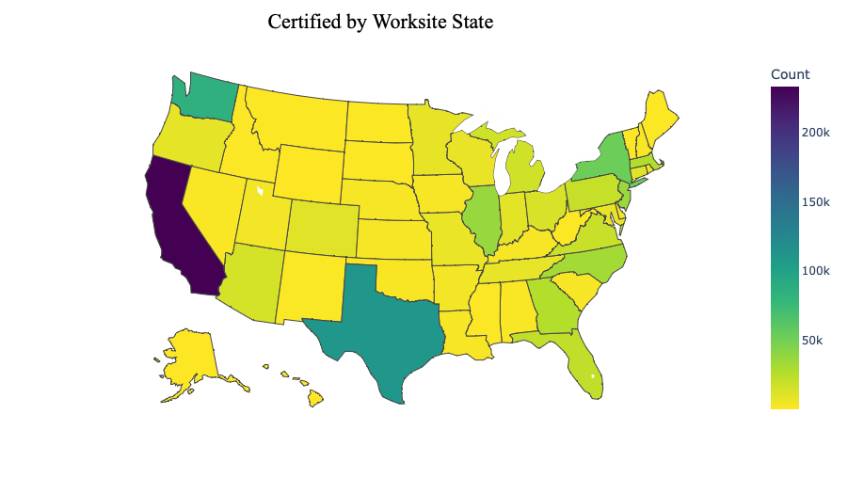
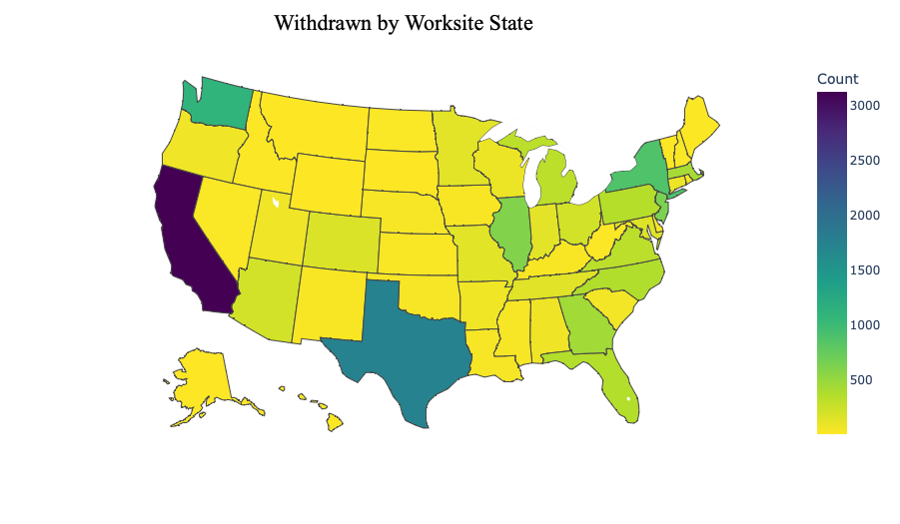
Data Visualization Maps by Worksite
Slide and Code by: Pranav Bhandari (ppb4)

Slide 6
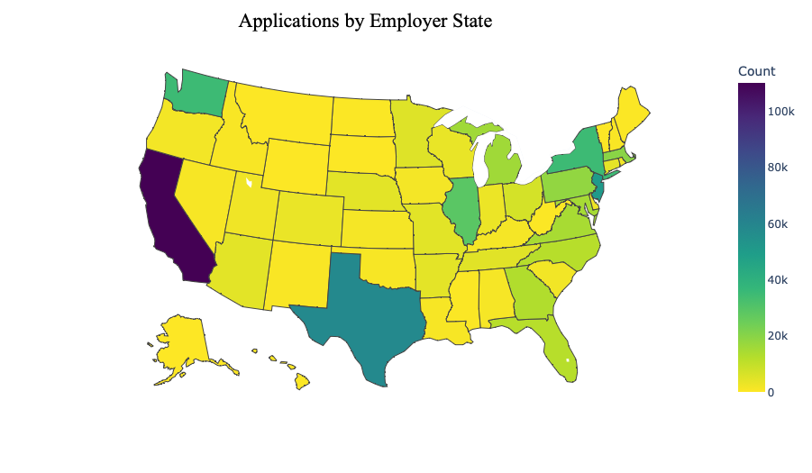
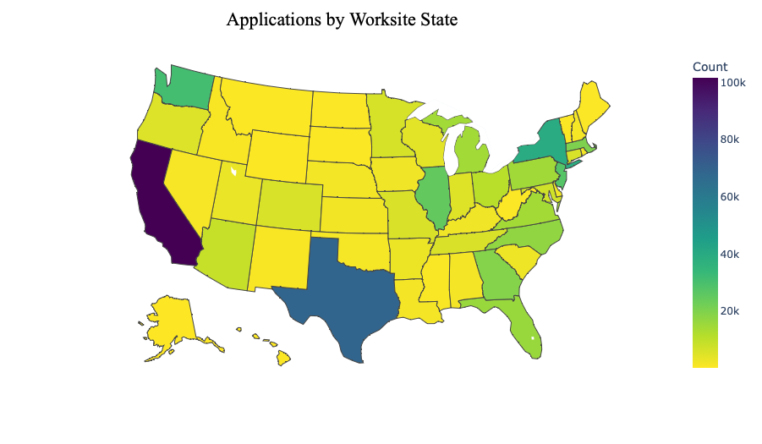
Data Visualization by Number of Applications
Slide and Code by: Pranav Bhandari (ppb4)

Slide 7
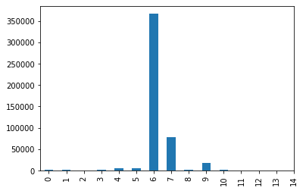
Number of Results per day within 2 weeks
Day 6 is the greatest in terms of replies
With a total of 350000+ all landing on day 6
Slide and Code by: Leo Franco Soto (francst2)
Notes:
Leo - Time Taken (Number of Days)

Slide 8
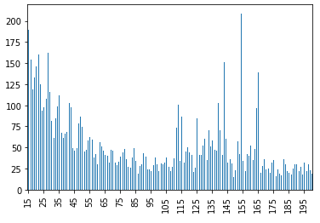
Number of Results per day 2+ weeks
Anything past the first two weeks usually gets very little replies.
This is possibly due to the number of withdrawn and denied applications in the first two weeks
Slide and Code by: Leo Franco Soto (francst2)
Notes:
Leo - Time Taken (Number of Days)

Slide 9
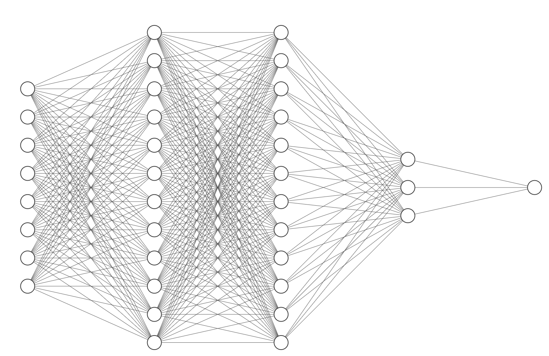
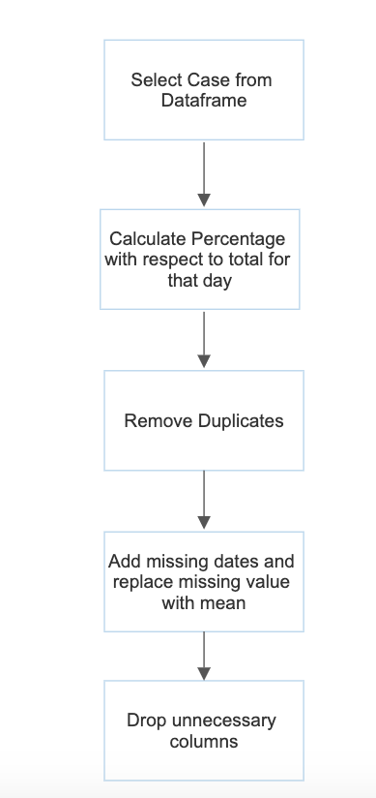
LSTM Model
Data
Preprocessing
LSTM Architecture
Input Layer
Hidden Layer 1: 100 nodes
Hidden Layer 2: 100 nodes
Dense Layer 1: 25 nodes
Dense Layer 2: 1 node
Epochs: 50, Optimizer: Adam, Loss: MSE
Slide and Code by: Pranav Bhandari (ppb4)

Slide 10
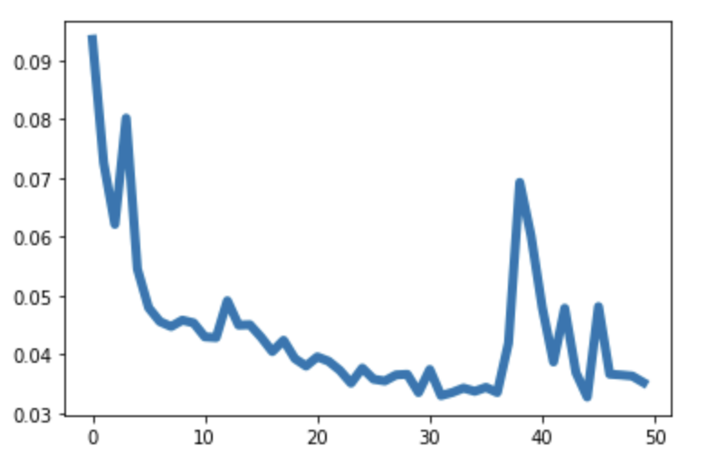
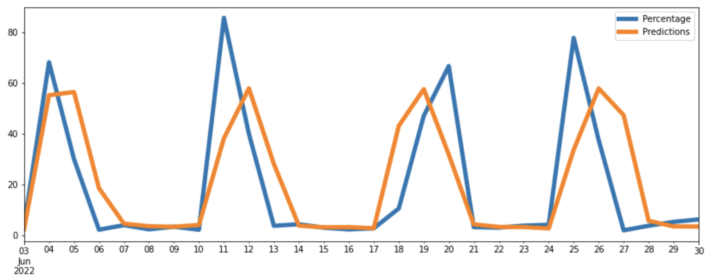
LSTM Result - Certified Withdrawn
Loss vs Epoch
Performance on Test Set
RSME: 19.95
Code and slides by: Pranav Bhandari (ppb4)

Slide 11
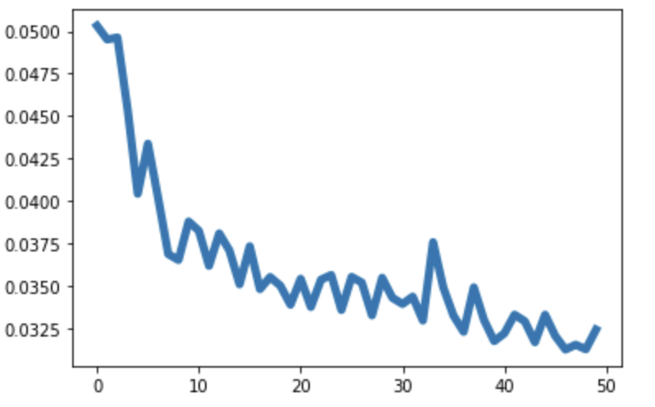
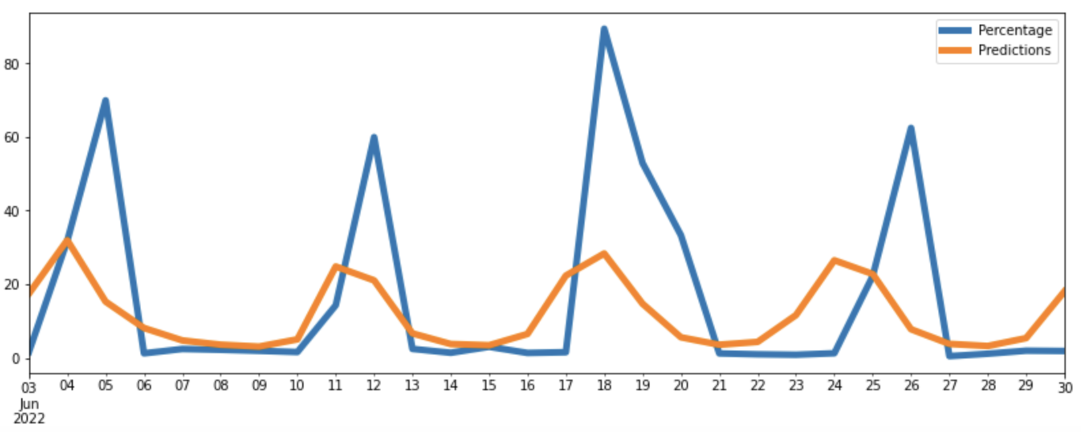
LSTM Result - Withdrawn
Loss vs Epoch
Performance on Test Set
RSME: 23.49
Code and slides by: Pranav Bhandari (ppb4)

Slide 12
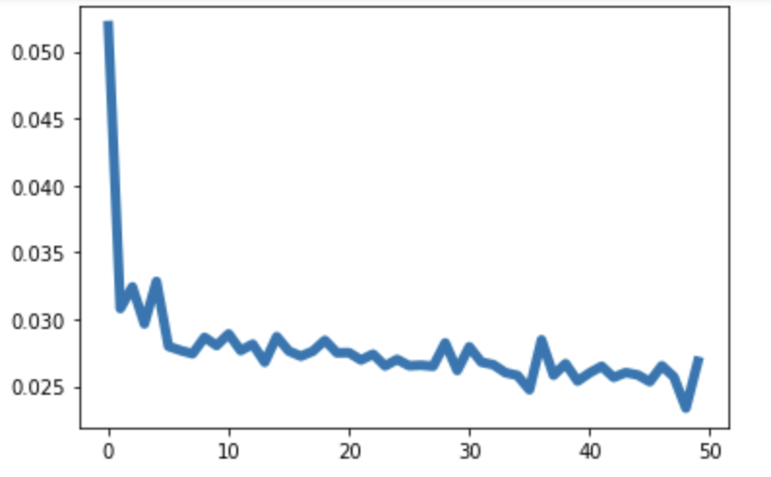
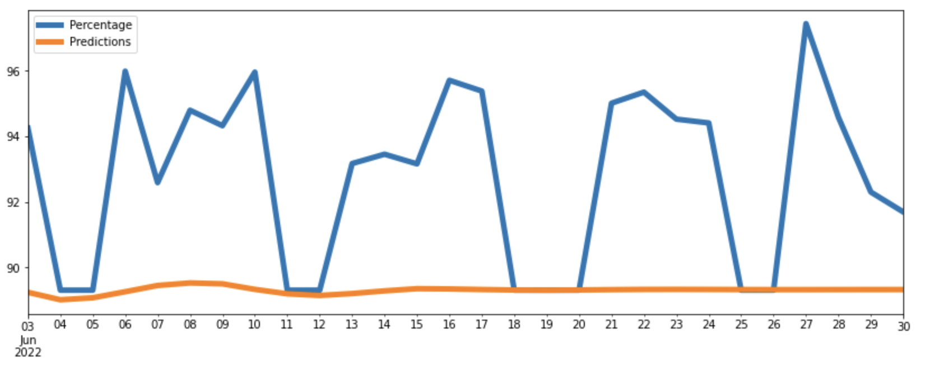
LSTM Result - Certified
Loss vs Epoch
Performance on Test Set
RSME: 4.35
Code and slides by: Pranav Bhandari (ppb4)

Slide 13
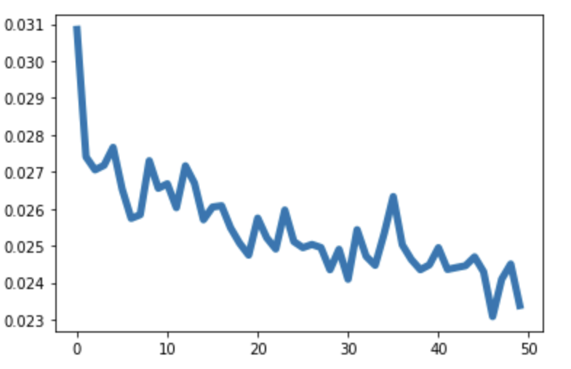
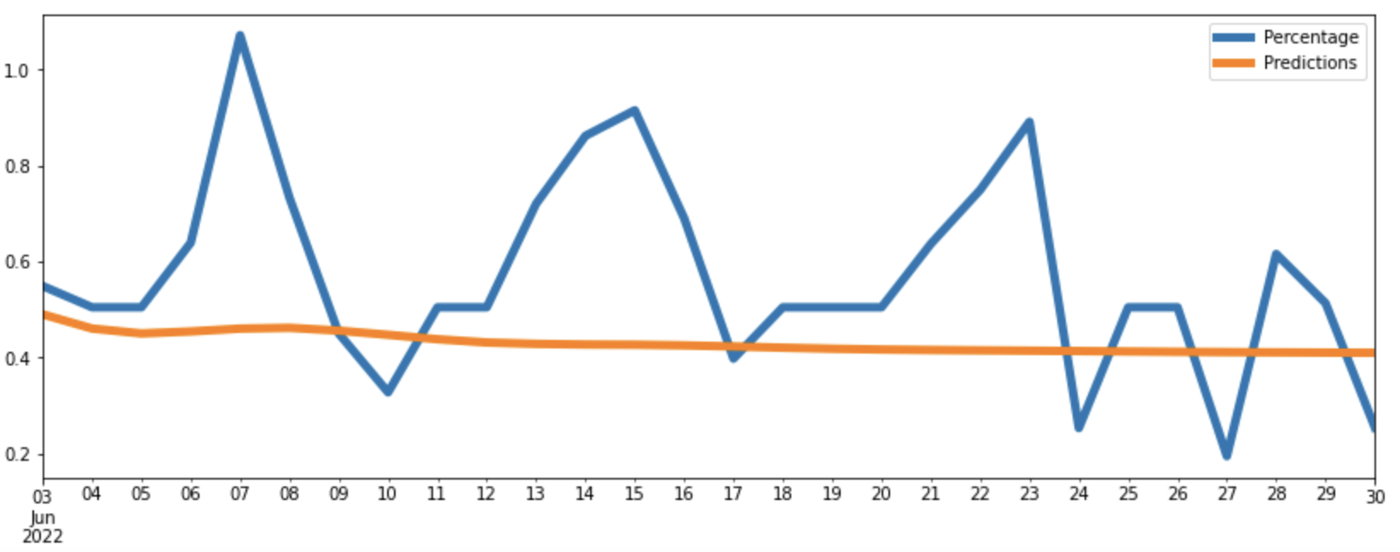
LSTM Result - Denied
Loss vs Epoch
Performance on Test Set
RSME: 0.24
Code and slides by: Pranav Bhandari (ppb4)

Slide 14
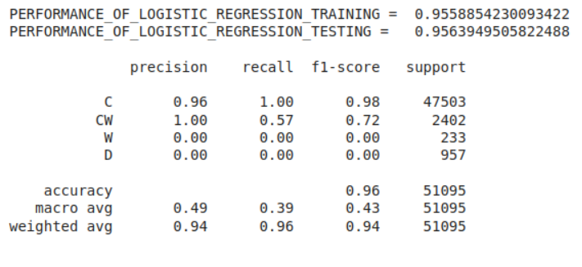
Benchmarking using Logistic Regression
Good at Classifying Certified and Certified Withdrawn Cases.
In our case, They comprise of 99.5% of the data. Performs horribly bad on W, and D cases.
Accuracy Overall - 95.6 %. (Pretty good)
Avg F-score - 0.43 (Not good)
Avg weighted Fscore - 0.94
Notes:
Add table of benchmarking using Logistic regression.
Discussion of results of Logistic regression

Slide 15
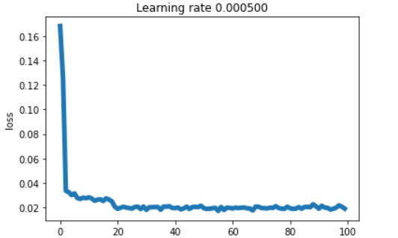
CNN
No. of Epochs - 100
Architecture -
Layersize - 8(input), 16, 16, 8, 8, 8, 4(output)
ReLU on all layers and Softmax on the last layer.
Performance doesn’t become better after 20th epoch.
Notes:
Add CNN architecture. CNN performance table.
Speak about trying even more complex models but accuracy doesn’t improve.

Slide 16
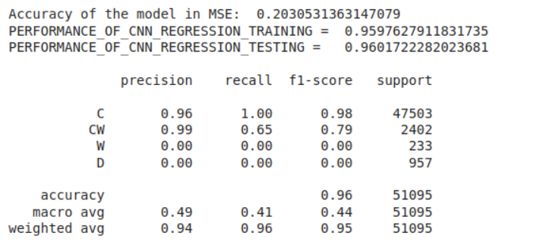
Performance of CNN Model.
Slightly Better Performance that Logistic Regression.
But since the model isn’t interpretable, we shouldn’t choose it as best model.
The data is not complex enough to require neural net to predict status.
Accuracy Overall - 96.0 %. (Pretty good) Avg F-score - 0.44 (Not good) Avg weighted F-score - 0.95
(All slightly better than logistic regression)
Notes:
Add the discussion points for comparison between cnn and LogReg everything in a table.

Slide 17
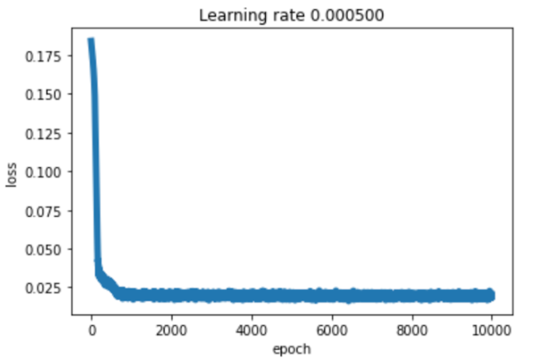
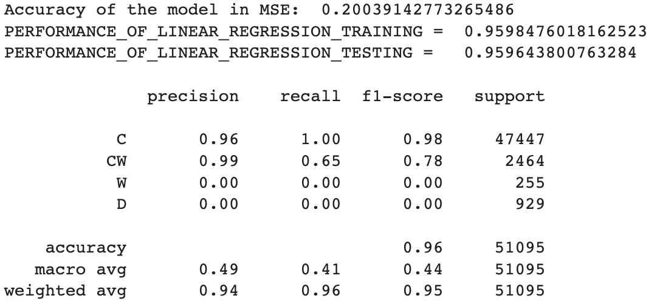
Running CNN with Different Optimizers (AdamW)
Slide by: Leo Franco Soto (francst2) Code by: Dushyant
Notes:
Leo - Running with different optimizers

Slide 18
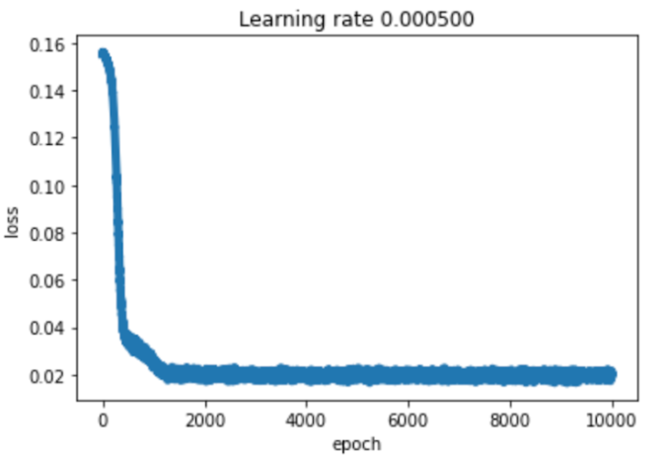
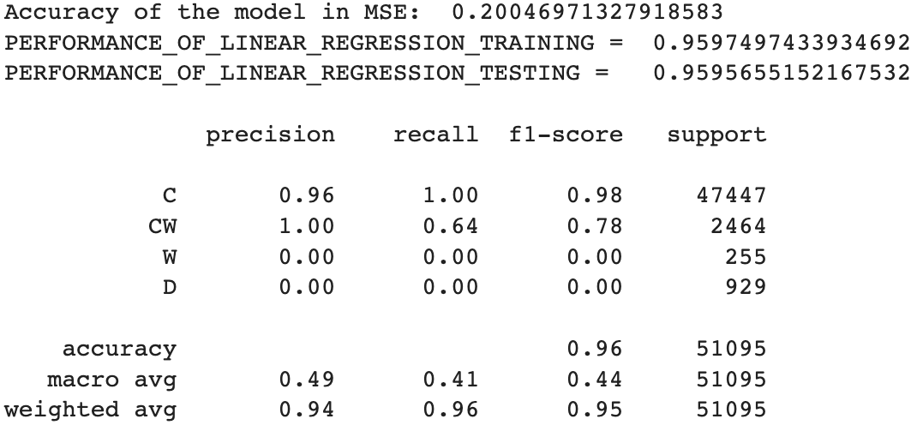
Running CNN with Different Optimizers (RAdam)
Slide by: Leo Franco Soto (francst2) Code by: Dushyant
Notes:
Leo - Running with different optimizers

Slide 19
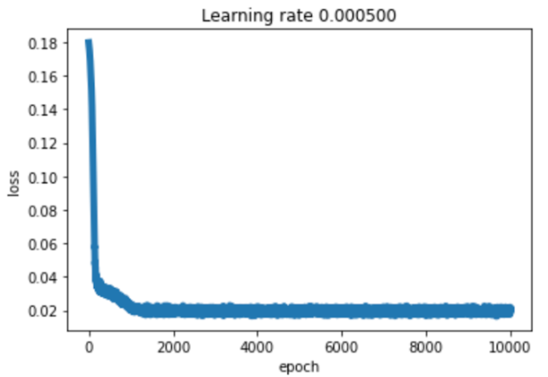

Running CNN with Different Optimizers (NAdam)
Slide by: Leo Franco Soto (francst2) Code by: Dushyant
Notes:
Leo - Running with different optimizers

Slide 20
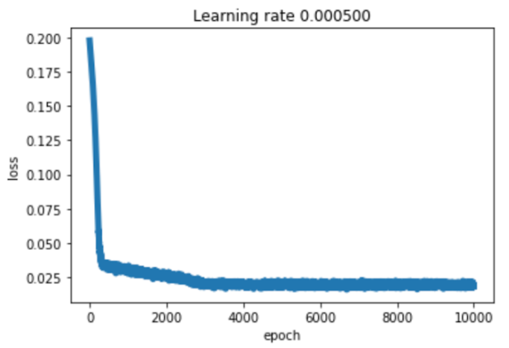
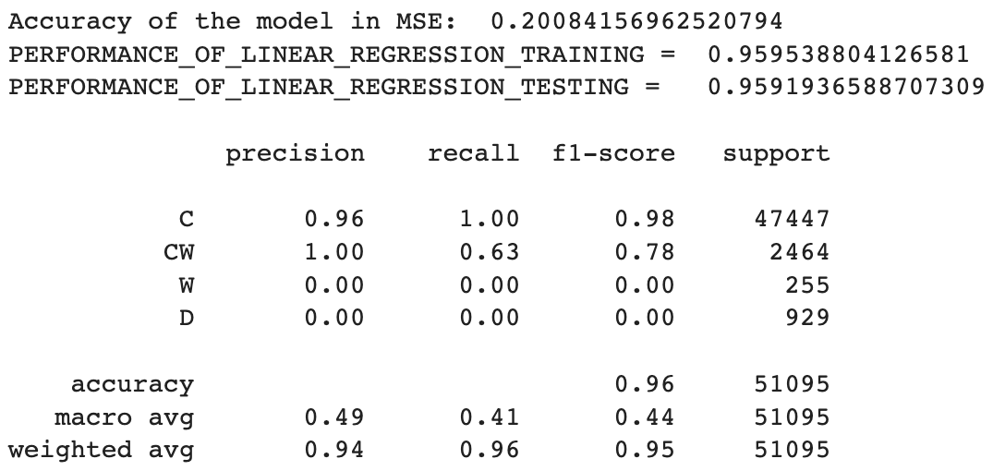
Running CNN with Different Optimizers (Adamax)
Slide by: Leo Franco Soto (francst2) Code by: Dushyant
Notes:
Leo - Running with different optimizers

Slide 21
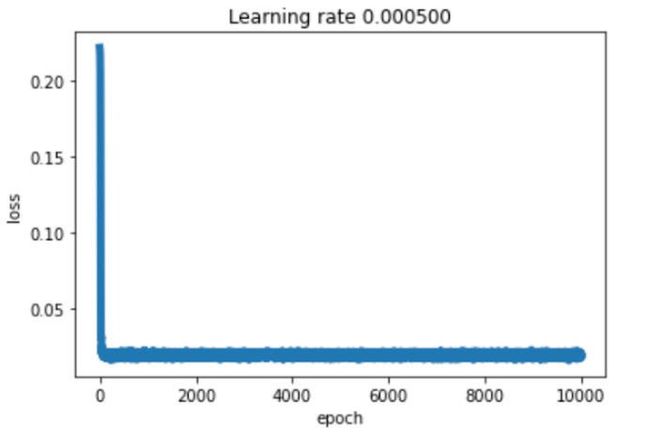

Running CNN with Different Optimizers (Rprop)
Slide by: Leo Franco Soto (francst2) Code by: Dushyant
Notes:
Leo - Running with different optimizers
Not surprisingly all these are similar to the best CNN - some other optimizers are not logistic, therefore do not fit the curve well and get a lesser than 95% training and testing performance.

Slide 22
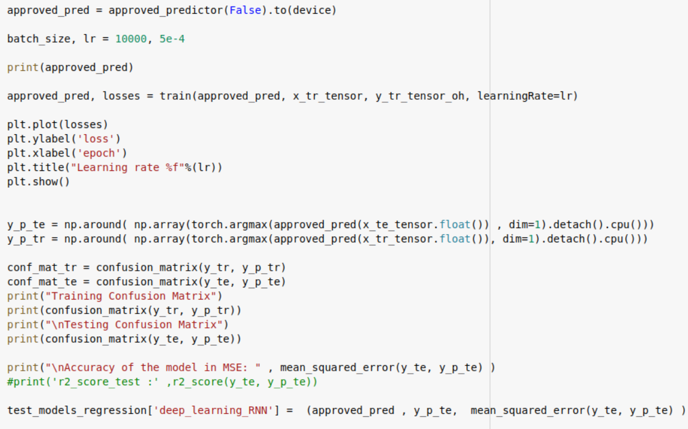
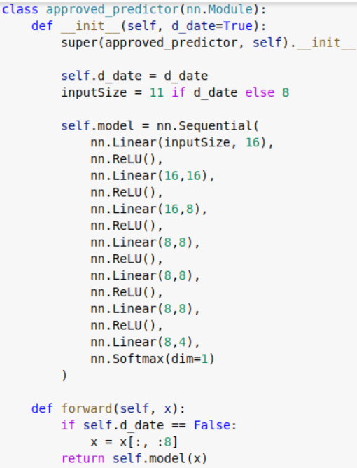
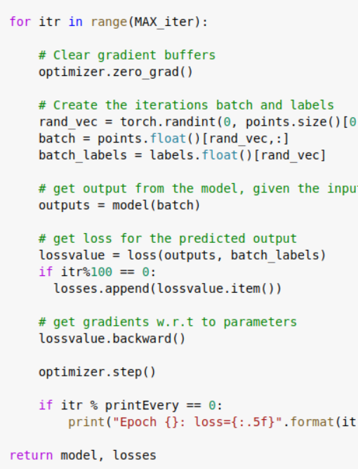
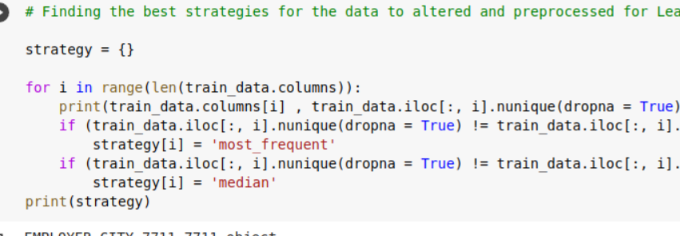
Code Snippets
Notes:
Coding snippets. Just add a few results and code. Small text is okay, professor will read it afterwards only. 3s.
Dushyant.

Slide 23
Thanks!

